Slide 1

Controlled E-Commerce Product Image Generation Using Stable Diffusion
Ibrahim Alborno CS 5542 – Quiz Challenge-1 April 20, 2026

Slide 2

Scenario Description
This project focuses on e-commerce product image generation using Stable Diffusion. The goal is to generate product images from structured metadata such as title, category, and attributes. This is useful because online stores need clean, high-quality product visuals, and generative AI can help automate that process.

Slide 3

Dataset / Input Data
This project uses a small structured metadata dataset with three sample products:
Men’s Running Shoes
Women’s Leather Handbag
Minimalist Ceramic Coffee Mug
Each product includes:
title
category
attributes
style
background

Slide 4
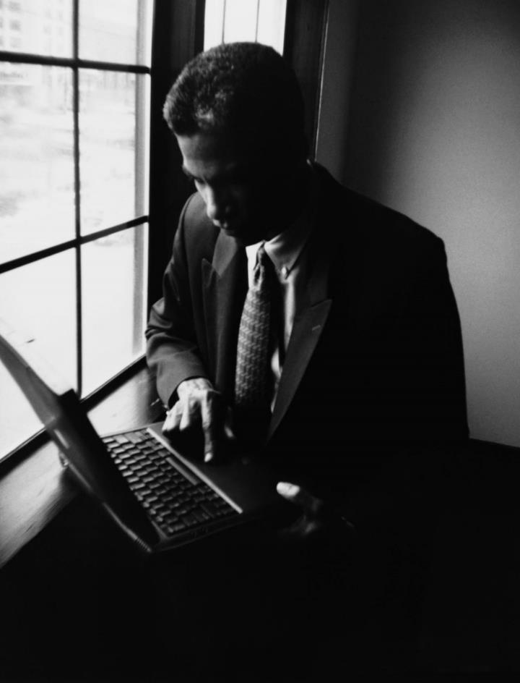
Methodology
We built a controlled image generation pipeline using Stable Diffusion. Product metadata was converted into prompts and tested using three strategies:
naive prompt
structured prompt
structured prompt plus negative prompt
The goal was to compare baseline and improved prompting strategies to see which produced better product images.

Slide 5

Stable Diffusion Pipeline
Pipeline steps:
Tools used:
Pipeline purpose:
define product metadata
create prompts from metadata
generate naive outputs
generate structured outputs
generate controlled outputs with negative prompting
save outputs
compare results
evaluate outputs
Google Colab
Python
Hugging Face Diffusers
Stable Diffusion v1.5
metadata → prompt → image generation
baseline vs controlled comparison
cleaner and more accurate product images
measurable evaluation of results

Slide 6

Prompt Design
Men’s Running Shoes
Structured Prompt Example Men’s Running Shoes, Footwear, black, white sole, sporty, mesh upper, studio product photography, clean white background, centered product shot, highly detailed
Negative Prompt Example blurry, distorted, extra objects, duplicate product, cropped, low quality, text, watermark, unrealistic proportions, messy background, bad lighting

Slide 7
Control Strategy
.
This project used:
structured prompt templates
negative prompts
Structured prompt templates improved prompt alignment by including important product details. Negative prompts helped reduce unwanted artifacts such as messy backgrounds, distortion, extra objects, and low-quality rendering.

Slide 8
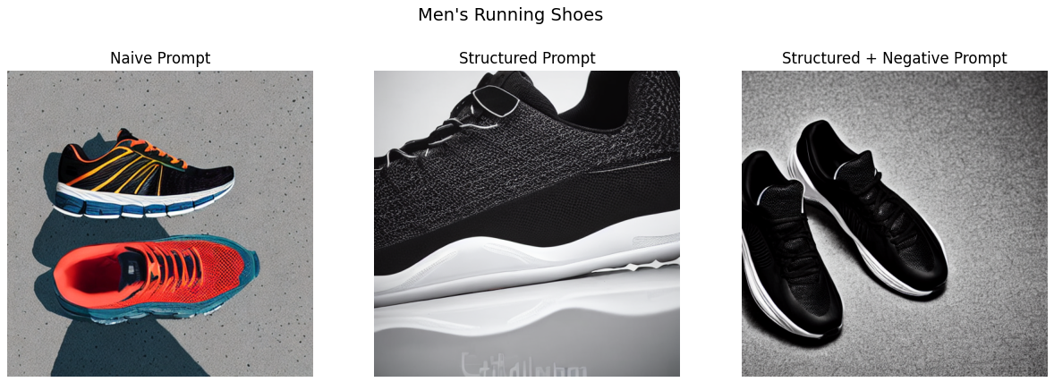
Results

Slide 9
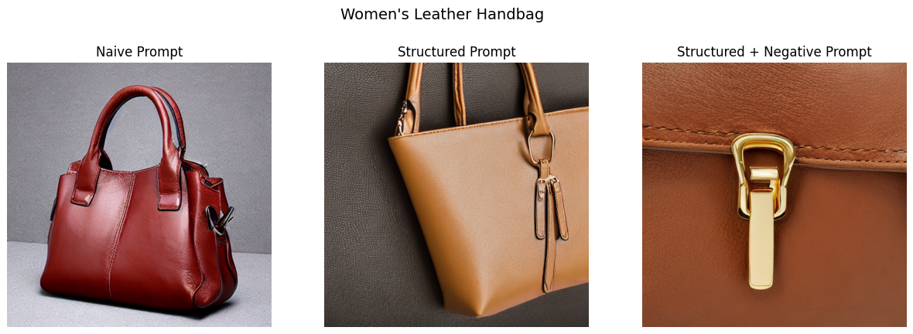
Results

Slide 10
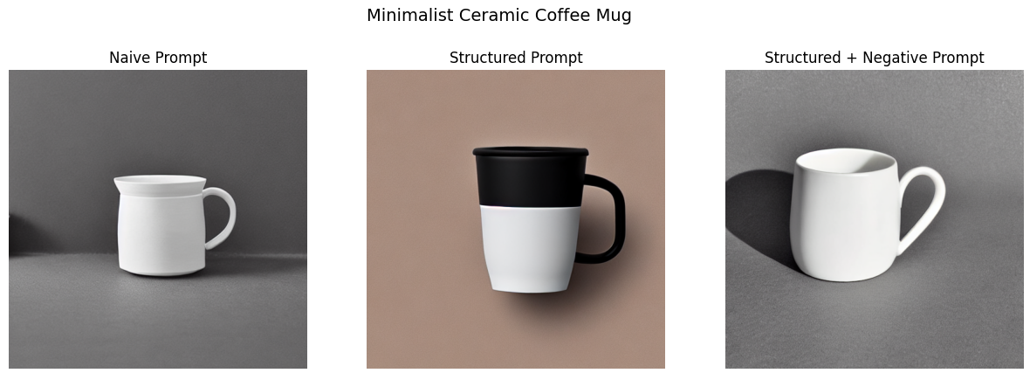
Results

Slide 11
Evaluation
Men’s Running Shoes
Women’s Leather Handbag
Minimalist Ceramic Coffee Mug
Prompt Alignment: 3
Consistency: 2
Diversity: 4
Quality: 3
Prompt Alignment: 4
Consistency: 4
Diversity: 3
Quality: 4
Prompt Alignment: 5
Consistency: 4
Diversity: 2
Quality: 5
The structured and controlled prompts generally improved alignment and quality, while naive prompts were less consistent across products.

Slide 12
Findings and Insights
.
The results showed that structured prompts generally improved product detail and visual control compared to naive prompts. For the running shoes, the naive version showed multiple shoes and less consistency, while the structured and controlled versions produced cleaner product-focused outputs. For the handbag, the structured prompt gave the best full-product result, while the controlled version improved detail but zoomed too far into the clasp. For the coffee mug, the controlled prompt produced the cleanest and most realistic result overall. These results show that prompt engineering improved alignment and presentation quality, although stronger control did not always produce the most useful full-product view.

Slide 13
Limitations / Failure Cases
.
Some failure cases included inconsistent object composition, zoomed-in framing, and variation in how fully the product was shown. In the running shoes results, some versions showed multiple shoes instead of one centered product image. In the handbag results, the controlled version focused too closely on the clasp, which reduced usefulness for e-commerce display. In the mug results, quality and alignment were strong, but the outputs were less diverse. These examples show that prompt control improves quality, but diffusion models can still produce framing and composition issues.

Slide 14
GitHub, Video, and AI Disclosure
.
GitHub URL: https://github.com/Ibrahim17A/Quiz-Challenge-1
Demo Video URL: https://youtu.be/ELXB5Kzanhc
AI Tools Used:
ChatGPT for project planning, code structure, and prompt design
Google Colab for running the notebook
Hugging Face Diffusers and Stable Diffusion v1.5 for image generation
Transparency Statement: All final outputs, comparisons, and analysis were reviewed and organized by the student.

